Slide 1
International Database of Ignitable Liquids
User Guide
6/29/2017

Slide 2
Search
If a user selects Show All Liquids, every sample record will be returned.
A user may refine their search by selecting multiple criteria. The search will return only those records that meet all of the selected criteria.

Slide 3
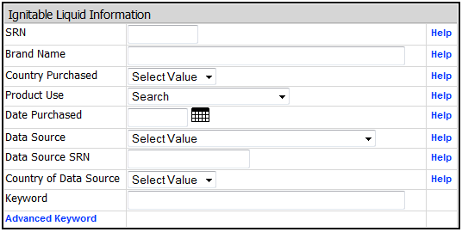
Search – ignitable liquid information
SRN: Sample Reference Number identifies each entry.
Brand Name: The brand or product name assigned by the distributor.
Product Use: The intended use for which the product is marketed.
Data Source: The laboratory that analyzed the ignitable liquid and submitted the data.
Data Source SRN: The submitting laboratory’s sample reference number, if applicable.

Slide 4
Search – keyword search
Advanced Keyword:

Slide 5
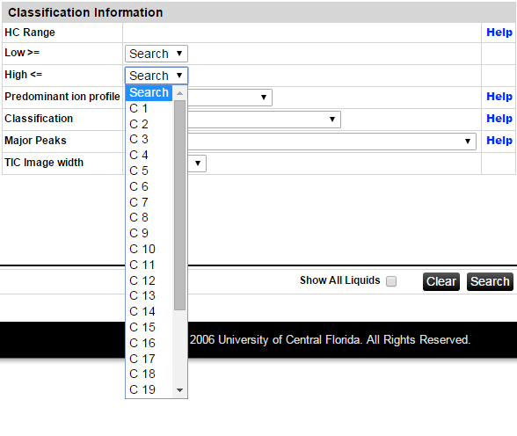
Search – selecting a carbon range
Select a low carbon number such as C8 (n-octane) and then a high carbon number such as C12 (n-dodecane).
Use a broad carbon range to avoid eliminating relevant database entries.

Slide 6
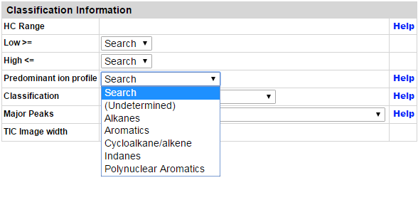
Search – selecting a predominant ion profile
Ion profile list is based on ASTM E1618-14.
The predominant ion profile determination is based on the ions and method used by the laboratory providing the sample data and information.

Slide 7
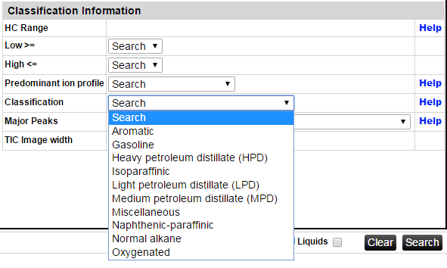
Search – selecting classifications
Classes are based on ASTM E1618-14.

Slide 8
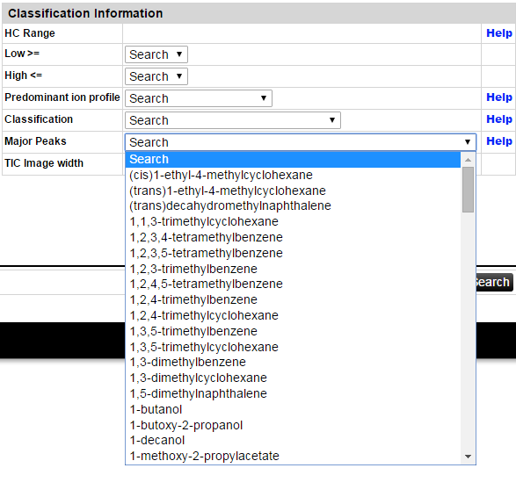
Search – selecting a major peak
A user can search for ignitable liquids containing a particular compound.
Only one compound can be searched at a time.

Slide 9
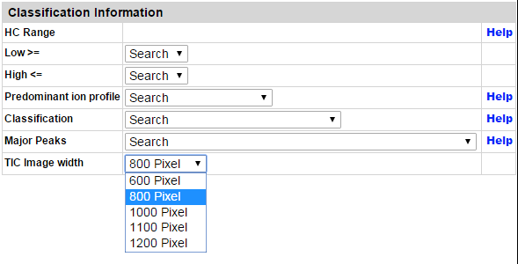
Search – selecting TIC image width
A user can specify the size of the TIC images in the search return.

Slide 10
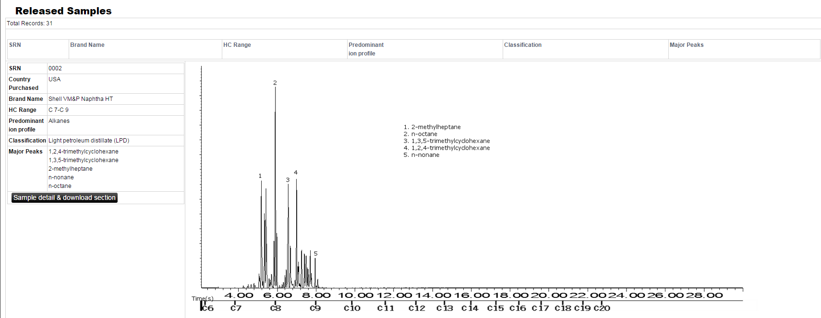
Search return
The total number of ignitable liquids matching the search criteria is displayed.
Click on the headers SRN, Brand Name, HC Range, Predominant ion profile, Classification or Major Peaks to re-sort the search return list.
Select Sample detail & download section for more sample information.

Slide 11
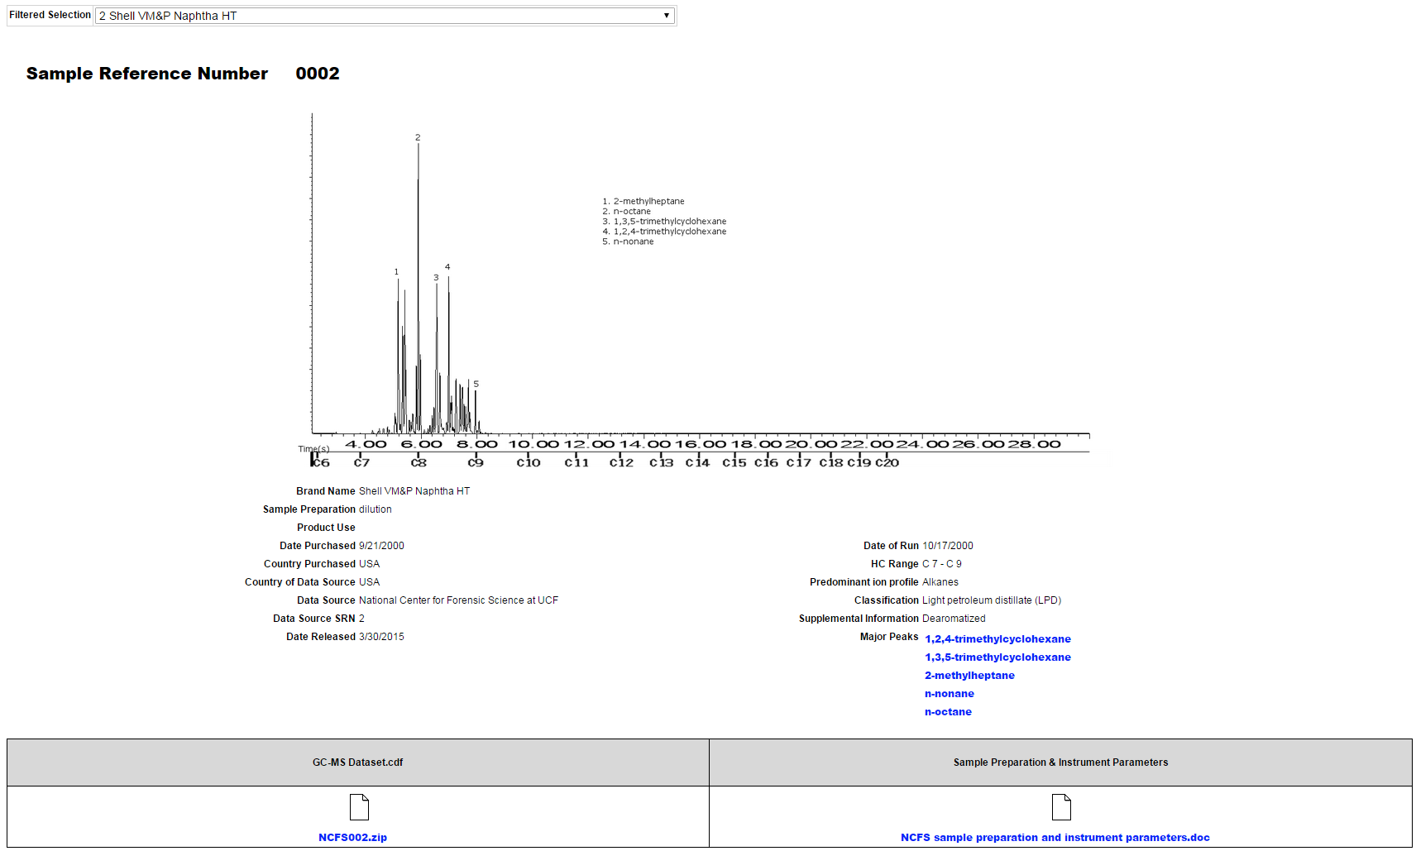
Sample detail & download section
Compounds in Major Peaks are linked to the NIST Webbook.
GC-MS files can be downloaded. The files are CDF format which can be opened in most MS software.
Sample preparation and instrument parameters can be found in this file.

